Slide 1

UE20CS390A – Capstone Project Phase – 1
Project Progress Review #3
Project Title : An Entity to 3D model Prototyping from a Photo
Project ID : PW23_NVP_02
Project Guide : Prof. Nitin V Pujari
Project Team : Nikita S Patgar [PES1UG21CS825]
Ravallu Nikhil Rajareddy [PES1UG21C830]
Titeersha Ghatak Chowdhury [PES1UG21CS834]
Vaishnavi .K [PES1UG21CS838]

Slide 2
An Entity to a 3d model Prototyping from a Photo
Abstract
The problem is to convert 2d images to 3D prototype using photos of human faces as input.
This involves taking photos of different people's faces, extracting features from those photos, and using the extracted features to generate gcode.
The gcode is then given to a 3D printer to create a 3D printed model of the face. The goal is to create accurate and detailed 3D printed models of human faces.

Slide 3
An Entity to a 3d model Prototyping from a Photo
Scope
The project aims to generate 3D printed models of human faces using photos as input. This involves extracting features from photos of different people's faces and using those features to generate g-code that can be used by a 3D printer to create a 3D printed model of the face.
The scope of the project includes several components:
The first component involves collecting photos of , which can be done by some set of photos taking photos or using existing photos.
The second component involves preprocessing the photos.
Nikita_Nikhil_Titeersha_Vaishnavi

Slide 4
An Entity to a 3d model Prototyping from a Photo
Scope
The third component involves feature extraction, which is the process of analyzing the photos and extracting key features that can be used to generate gcode.
The fourth component involves generating gcode from the extracted features, which is the set of instructions that tells the 3D printer how to create the 3D printed model. This may involve using a tool or library that converts the features into gcode that can be read by a 3D printer.
The fifth component involves 3D printing the model using the generated g-code. This may involve using a 3D printer and the appropriate printing material.
Nikita_Nikhil_Titeersha_Vaishnavi

Slide 5
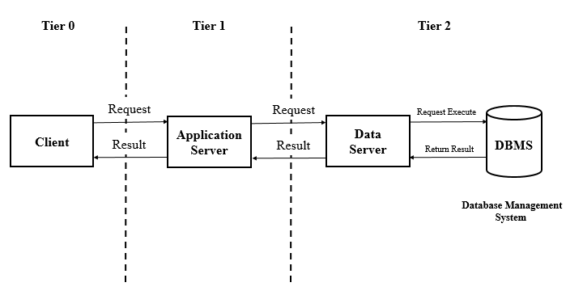
An Entity to a 3d model Prototyping from a Photo
Design Approach
Client Server Model
Notes:
Iterative process starts with a simple implementation of a subset of the software requirements and iteratively enhances the evolving versions until the full system is implemented. At each iteration, design modifications are made and new functional capabilities are added. The basic idea behind this method is to develop a system through repeated cycles (iterative) and in smaller portions at a time (incremental).

Slide 6
An Entity to a 3d model Prototyping from a Photo
Design Approach
Client Server Model[3-Tier Architecture]
Related to our project ,
User i.e, The computer will be working as a client, which will interact with application.
User interface will be working as application server, which requests the ML model.
ML model used will be taking role of data server with respect to client-server model, communicates with DB.
And DataBase contains the images which are extracted from the ML model and will be responding to the ML model when it requests.
Notes:
Iterative process starts with a simple implementation of a subset of the software requirements and iteratively enhances the evolving versions until the full system is implemented. At each iteration, design modifications are made and new functional capabilities are added. The basic idea behind this method is to develop a system through repeated cycles (iterative) and in smaller portions at a time (incremental).

Slide 7
An Entity to a 3d model Prototyping from a Photo
Design Constraints and Assumptions
There is no Design Constraint .
But Assumptions to be made are :-
User will be uploading the photo which contains atleast one human face.
The output may not be accurate.

Slide 8
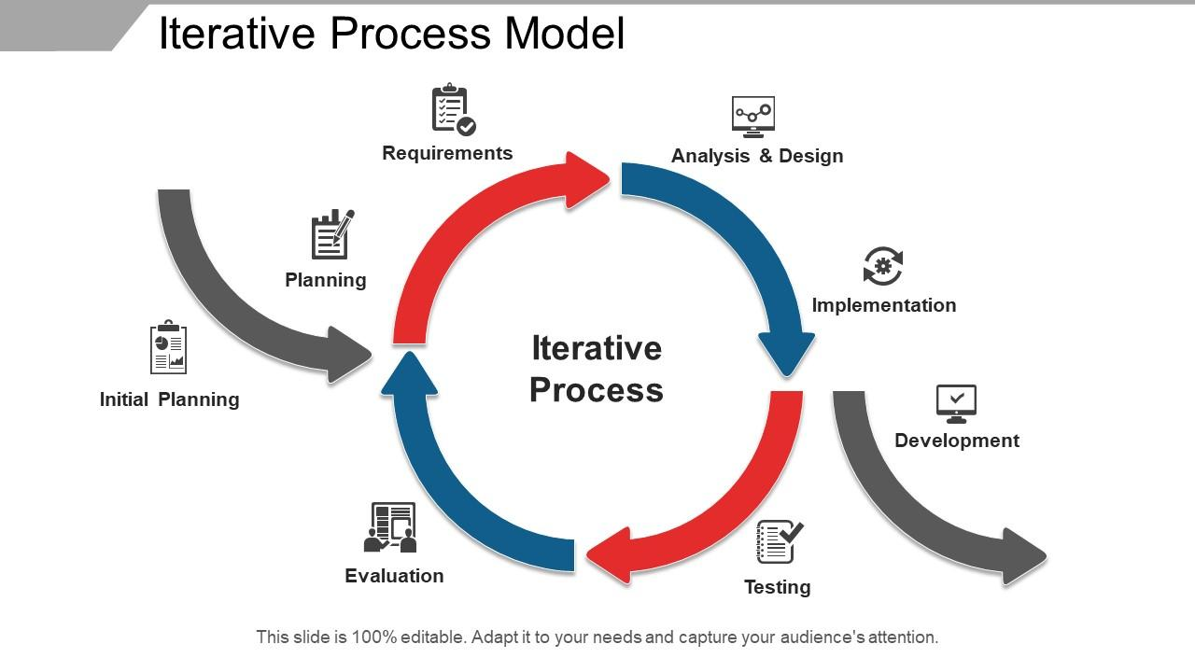
An Entity to a 3d model Prototyping from a Photo
Proposed Methodology / Approach
Iterative Model
Iterative process starts with a simple implementation of a subset of the software requirements and iteratively enhances the evolving versions until the full system is implemented. At each iteration, design modifications are made and new functional capabilities are added.

Slide 9
An Entity to a 3d model Prototyping from a Photo
Proposed Approach
Benefits of this approach :
Progress can be measured.
Some working functionality can be developed quickly and early in the life cycle.
Less costly to change the scope/requirements.
Easier to manage risk
Notes:
Iterative process starts with a simple implementation of a subset of the software requirements and iteratively enhances the evolving versions until the full system is implemented. At each iteration, design modifications are made and new functional capabilities are added. The basic idea behind this method is to develop a system through repeated cycles (iterative) and in smaller portions at a time (incremental).

Slide 10
An Entity to a 3d model Prototyping from a Photo
Proposed Approach
Drawbacks of this approach
Management complexity is more.
Not suitable for smaller projects.
Notes:
Iterative process starts with a simple implementation of a subset of the software requirements and iteratively enhances the evolving versions until the full system is implemented. At each iteration, design modifications are made and new functional capabilities are added. The basic idea behind this method is to develop a system through repeated cycles (iterative) and in smaller portions at a time (incremental).

Slide 11
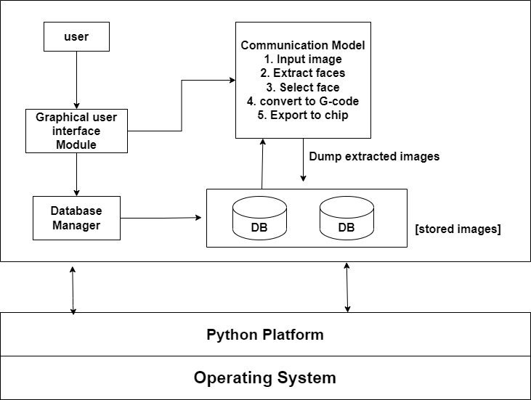
An Entity to a 3d model Prototyping from a Photo
High Level Design(HLD) Architecture

Slide 12
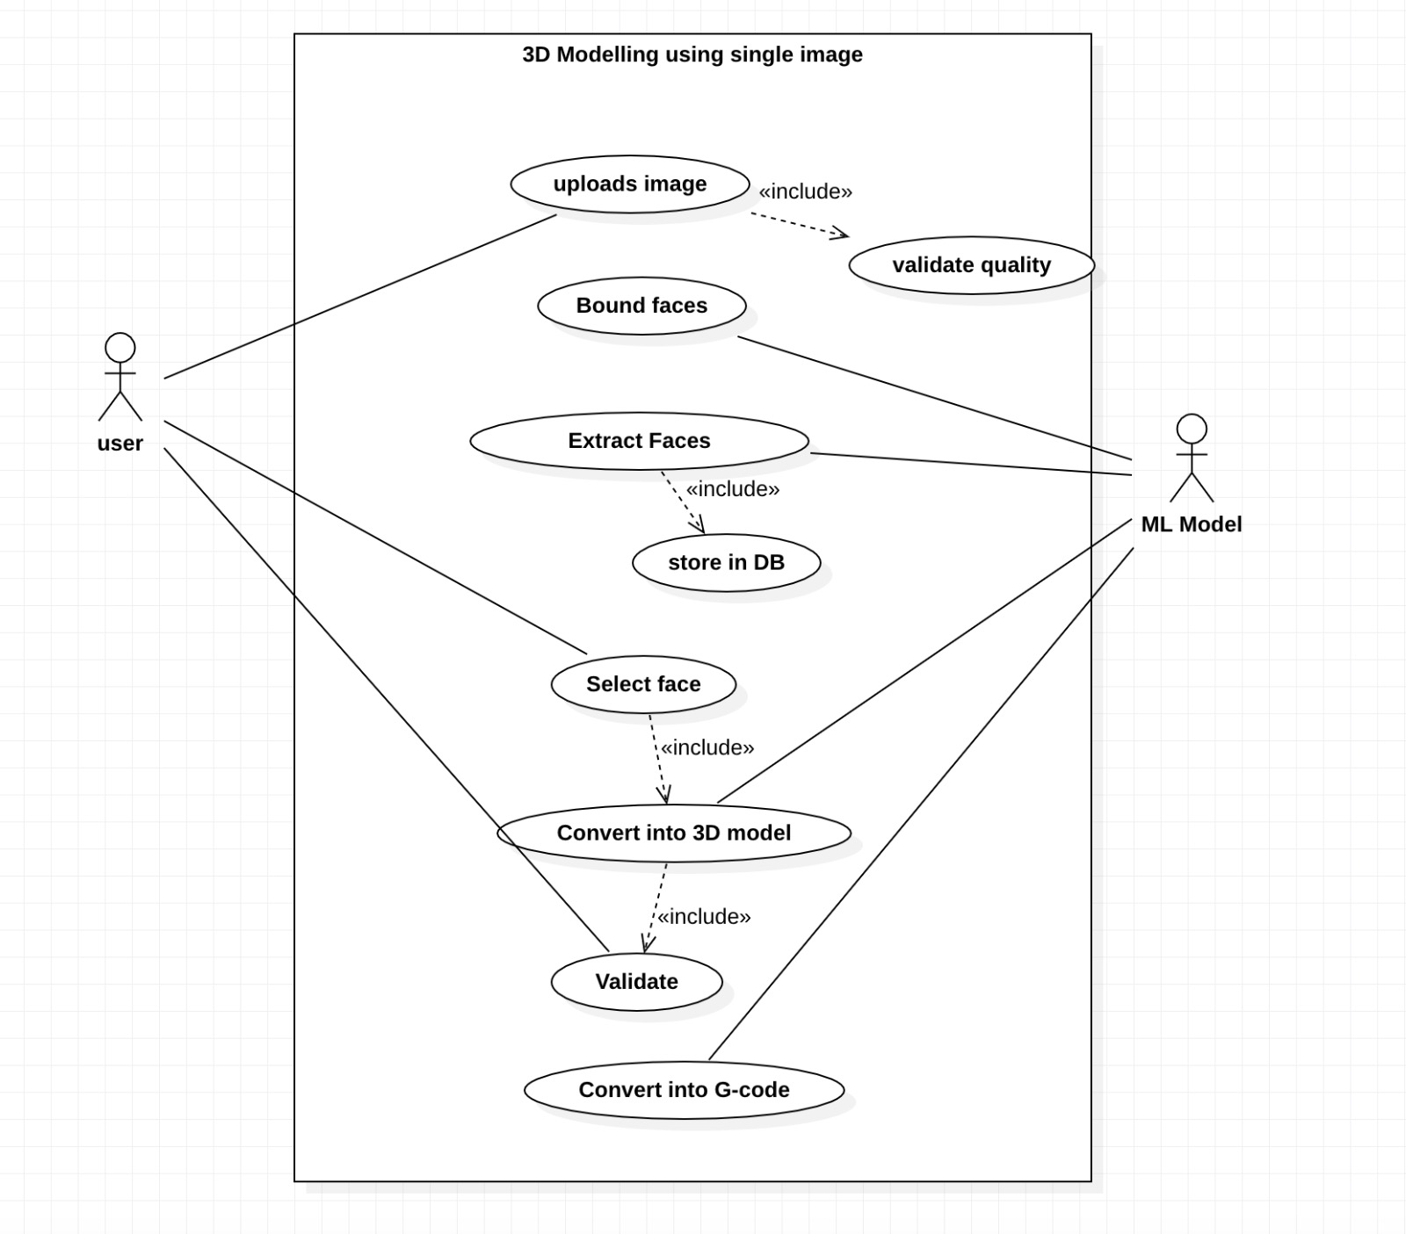
An Entity to a 3d model Prototyping from a Photo
Use Case Diagram Design Description

Slide 13
An Entity to a 3d model Prototyping from a Photo
External Interfaces Design Description
User Interface
Hardware requirements
Software requirements

Slide 14
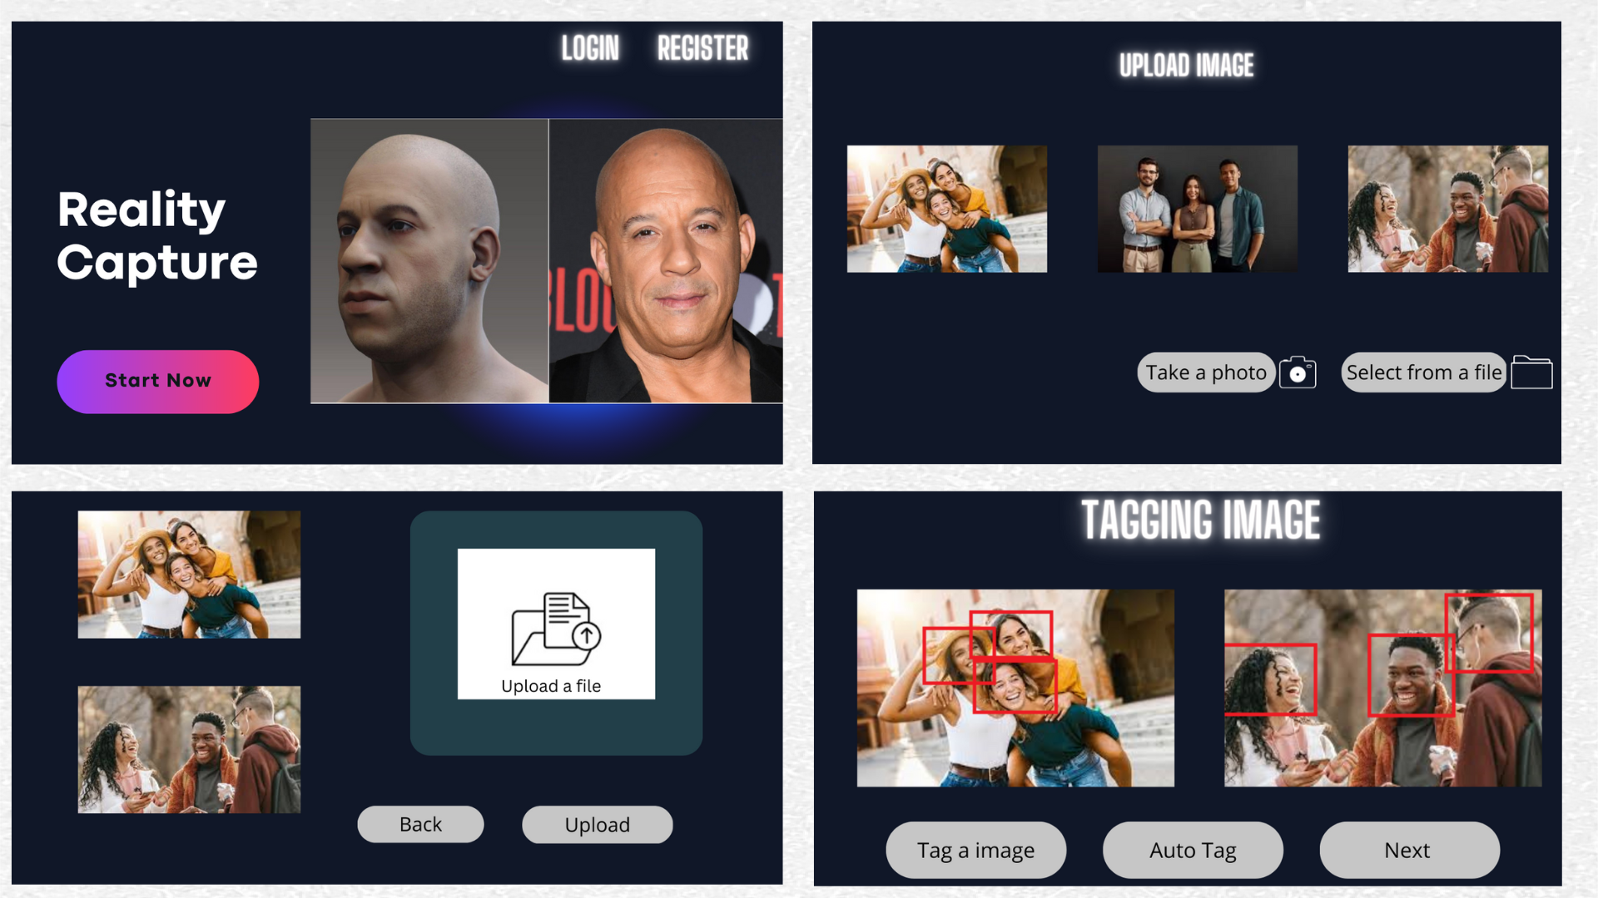
An Entity to a 3d model Prototyping from a Photo
External Interfaces Design Description
User Interface

Slide 15
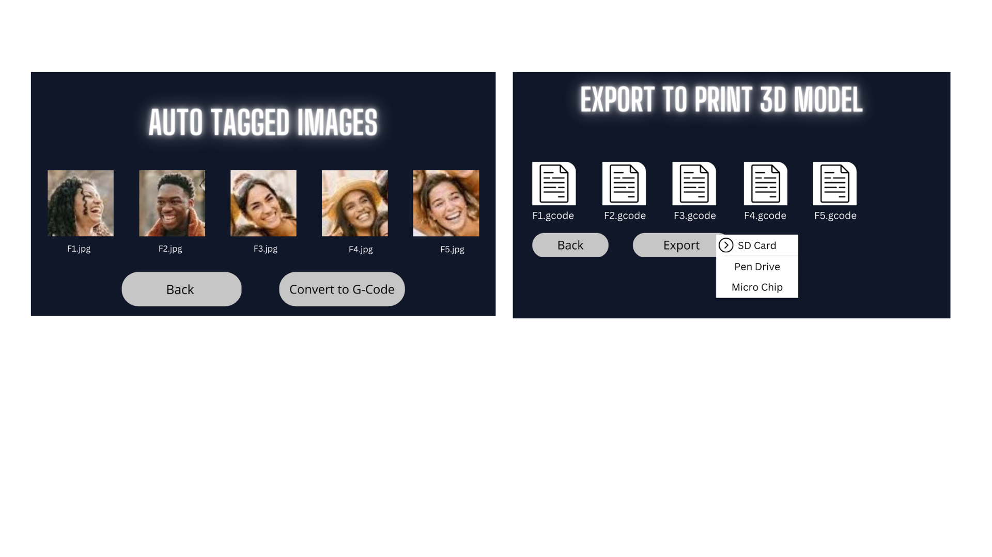
An Entity to a 3d model Prototyping from a Photo
External Interfaces Design Description
User Interface

Slide 16
An Entity to a 3d model Prototyping from a Photo
External Interfaces Design Description
Hardware and Software Requirements
Hardware requirements:
Computer
Camera
Graphic Card
Software requirements:
Compatible OS
Python Compiler
Required libraries

Slide 17
An Entity to a 3d model Prototyping from a Photo
Technologies Used
TensorFlow, PyTorch, and Keras - are useful for building the AI/ML model.
Scikit-image, OpenCV - provides a collection of algorithms for image processing, including segmentation and feature extraction.
Convolutional Neural Networks (CNNs) - are effective for image recognition and feature extraction
Generative Adversarial Networks (GANs) - can be used to generate 3D models based on the 2D images.
Blender, Autodesk Fusion 360 - Software used to convert the generated 3D models into printable g-code.

Slide 18
An Entity to a 3d model Prototyping from a Photo
Project Demo
High-level algorithm for extracting and bounding faces from an image and creating a database:
1. Load the input image.
2. Convert the image to grayscale for better contrast and easier processing.
3. Detect faces in the image using a face detection algorithm, such as Haar cascades, which can be implemented using OpenCV or other computer vision libraries.
4. For each detected face, create a bounding box around it to localize the face in the image.
5. Crop the image using each bounding box to extract the face as a separate image.

Slide 19
An Entity to a 3d model Prototyping from a Photo
Project Demo
6. Save each face image to a separate file in a database/folder.
7. Generate 2^n combinations of face images by selecting all possible combinations of n faces from the database/folder.
8. Store each combination as a separate file in a database/folder.
9. Allow users to upload images by providing a file upload feature or allowing them to enter the image name manually.
10. Repeat steps 1-8 for each uploaded image.

Slide 20
An Entity to a 3d model Prototyping from a Photo
Project Progress
So far, we are working on the bounding of Faces from the input image.
Based on current assessment, the project has been completed up to 20% to 25% of its overall scope.
We are monitoring the progress and making adjustments as necessary to ensure that we meet the project objectives within the given timeframe.

Slide 21
An Entity to a 3d model Prototyping from a Photo
References
A. A. Khleif and A. A. Shnawa, "Vision system aided 3D object reconstruction and machining using CNC milling machine," 2018 International Conference on Advance of Sustainable Engineering and its Application (ICASEA), Wasit - Kut, Iraq, 2018, pp. 249-254, doi: 10.1109/ICASEA.2018.8370990.[1]
P. Ji, L. Wang, D. -X. Li and M. Zhang, "An automatic 2D to 3D conversion algorithm using multi-depth cues," 2012 International Conference on Audio, Language and Image Processing, Shanghai, China, 2012, pp. 546-550, doi: 10.1109/ICALIP.2012.6376677.[2]
Manbae Kim, "2D-to-3D conversion using color and edge," 2014 International SoC Design Conference (ISOCC), Jeju, Korea (South), 2014, pp. 171-172, doi: 10.1109/ISOCC.2014.7087681.[3]
K. Yamada and Y. Suzuki, "Real-time 2D-to-3D conversion at full HD 1080P resolution," 2009 IEEE 13th International Symposium on Consumer Electronics, Kyoto, Japan, 2009, pp. 103-106, doi: 10.1109/ISCE.2009.5156848.[4]

Slide 22
Thank You

